Slide 1





Molecular orbital theory and its application to form homo (H2 N2 &O2) and hetero (HF,NO) diatomic molecules.

Slide 2






Molecular Orbital (MO) Theory
Developed by F. Hund and R.S. Mulliken in 1932
Diagram of molecular energy levels
Magnetic and spectral properties
  Paramagnetic vs. Diamagnetic
  Electronic transitions
  Solid State - Conductance
Predicts existence of molecules
  Bond Order

Slide 3






Molecular Orbital (MO) Theory
Two atomic orbitals combine to form
  a bonding molecular orbital
  an anti-bonding molecular orbital
e⁻ in bonding MO’s = stability
e⁻ in anti-bonding MO’s = instability
# atomic orbitals combined equals # of molecular orbitals formed
The molecular orbitals like atomic orbitals are filled in accordance with the aufbau principle obeying the Pauli’s exclusion principle and the Hund’s rule.

Slide 4

Central Themes
Quantum mechanical level
  Molecule viewed as a collection of nuclei surrounded by delocalized molecular orbitals
Atomic wave functions are summed to obtain molecular wave functions.
  If wave functions reinforce each other, a bonding MO is formed (region of high electron density exists between the nuclei).
  If wave functions cancel each other, an antibonding MO is formed (a node of zero electron density occurs between the nuclei).

Slide 5


 Formation of Molecular Orbitals Linear combination of Atomic Orbitals (LCAO)
The atomic orbitals of these atoms may be represented by the wave functions ψA and ψB.
Therefore, the two molecular orbitals σ and σ* are formed as :
σ = C₁ϕ _{A} + C₂ϕ_{B}
σ * = C₁ϕ_{A} − C₂ϕ_{B}
Where the coefficients C, indicate the contribution of the AO to the MO

Slide 6

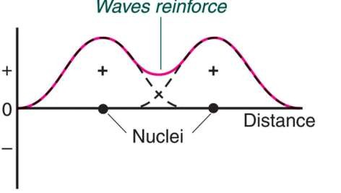
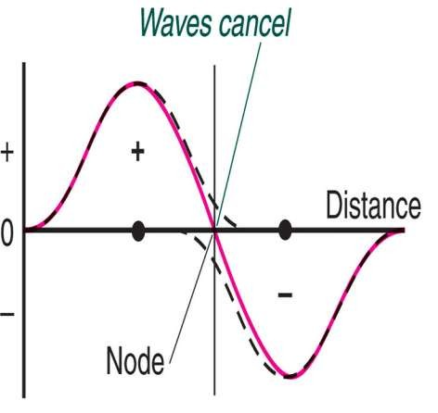

An Analogy
Amplitudes of wave functions added
Amplitudes of wave functions subtracted.

Slide 7

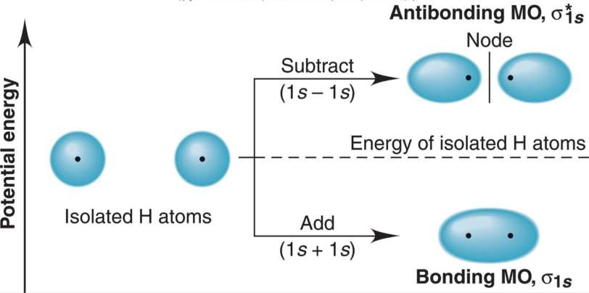
MO: Molecular Hydrogen
The bonding MO is lower in energy than an AO
The anti- bonding MO is higher in energy than an AO

Slide 8

Considerations…
Bond Order =1/2( # bonding e⁻ – # antibonding e⁻ )
Higher bond order = stronger bond
Molecular electron configurations
  Highest Occupied Molecular Orbital = HOMO
  Lowest Unoccupied Molecular Orbital = LUMO
An Example: H₂ (σ_{1s})²

Slide 9

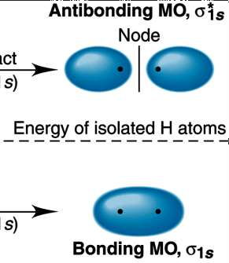
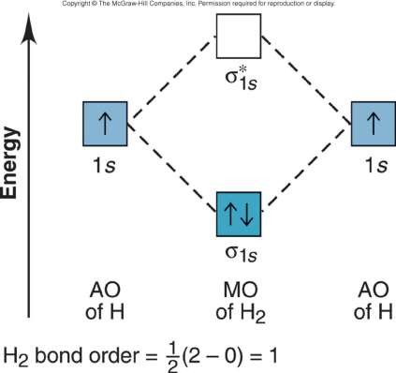
MO: Molecular Hydrogen

Slide 10
















Predicting Stability: H₂⁺ & H₂⁻
bond order
= 1/2(1-0)
= 1/2
bond order
= 1/2(2-1)
= 1/2
σ∗
σ∗
H₂⁺ does exist
H₂⁻ does exist
1s
_{1s} 1s
AO of H AO of H
1s
AO of H⁻
AO of H
σ
MO of H₂⁺
σ
configuration is (σ_{1s})²(σ∗_{1s})¹
configuration is (σ_{1s})¹
MO of H ⁻
2

Slide 11

Helium: He₂⁺ vs He₂
σ*_{1s}
σ*_{1s}
Energy
Energy
1s
1s
1s
1s
^{σ}1s
MO of AO of He⁺ He⁺
^{σ}1s
AO of MO of AO of He He₂ He
He₂ bond order = 0
AO of He
He₂⁺ bond order = 1/2

Slide 12


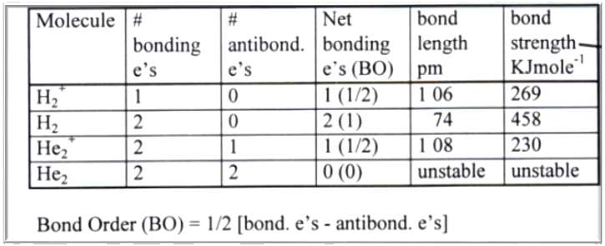

Slide 13

Next Row: 2s & 2p orbitals
σ*₂
s
σ*₂
s
2s
2s
Energy
Li
Bonding in s-block homonuclear diatomic molecules.
Be₂
2
^{σ}2s
σ
2s
σ*₁
s
σ*₁
s
1s
1s
Li₂ B.O. = 1
Be₂ B.O. = 0
^{σ}1s
^{σ}1s

Slide 14

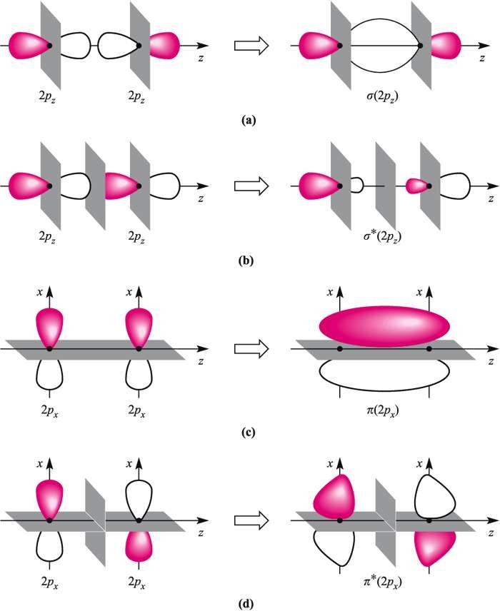
Combinations for p-orbitals
Axial symmetry means σ bond
Non-axial symmetry means π bond

Slide 15

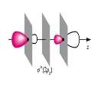
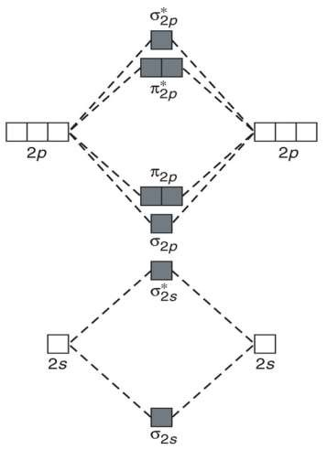

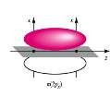

MO – Now with S & P
X 2
X 2

Slide 16

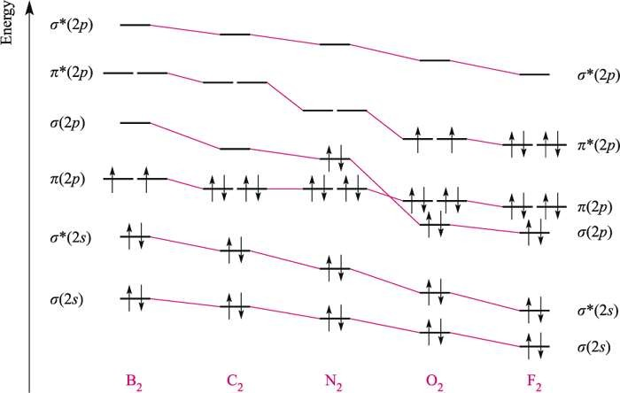
S - P orbital mixing

Slide 17

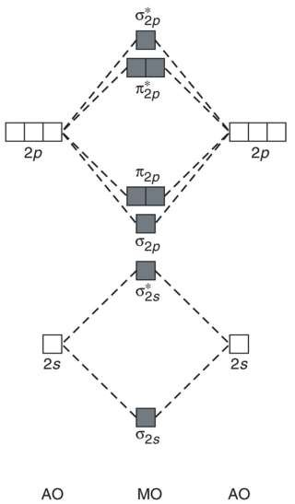
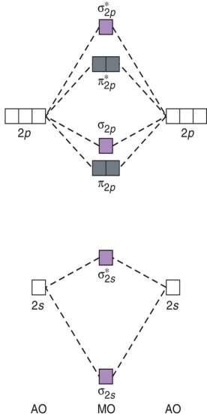
Relative Energy Levels for 2s & 2p
WITHOUT big 2s-2p repulsion
WITH big 2s-2p repulsion
MO energy levels for O₂, F₂, and Ne₂
MO energy levels for B₂, C₂, and N₂

Slide 18

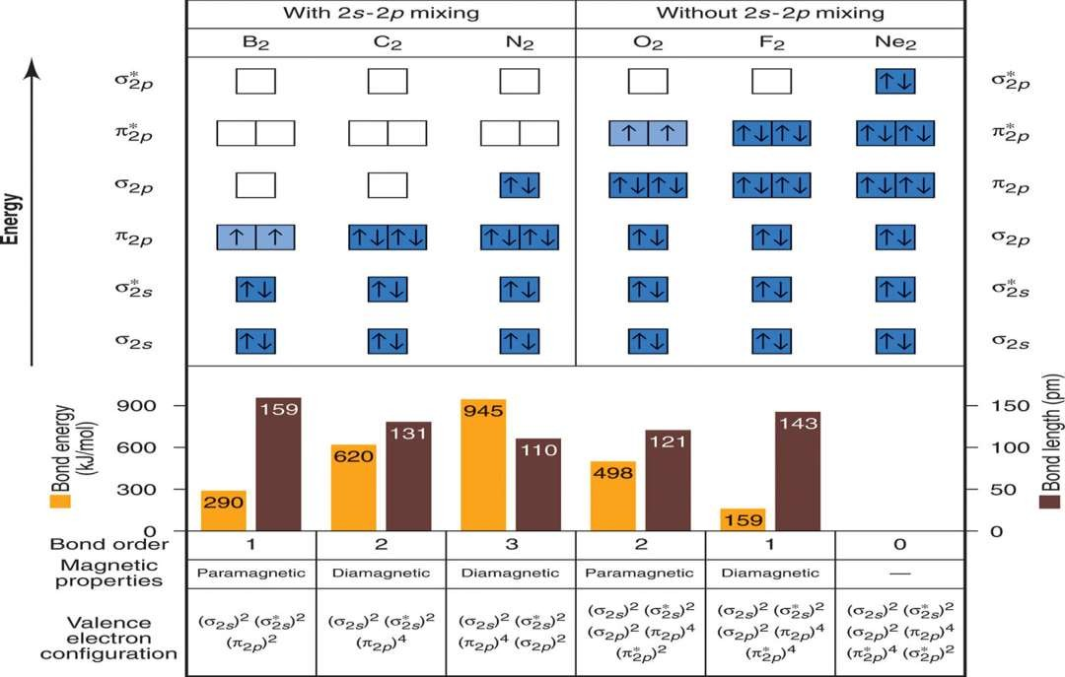

Slide 19

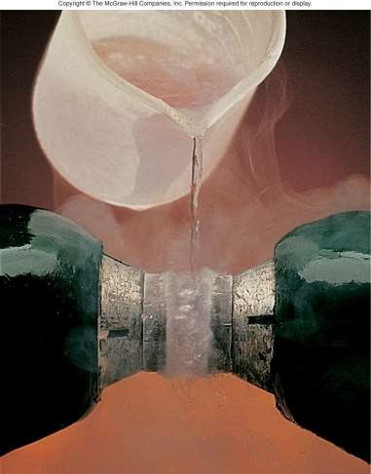
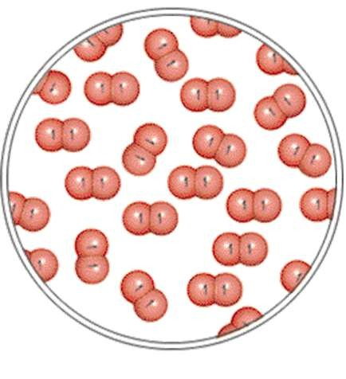
Triumph for MO Theory?

Slide 20














Can MO Theory Explain Bonding?
PROBLEM:
As the following data show, removing an electron from N₂ forms an ion with a weaker, longer bond than in the parent molecules, whereas the ion formed from O₂ has a stronger, shorter bond:
_{N2}+ _{O2}+
N₂ O₂
Bond energy (kJ/mol) | 945 | 841 | 498 | 623
Bond length (pm) | 110 | 112 | 121 | 112
Explain these facts with diagrams that show the sequence and occupancy of MOs.
PLAN:
Find the number of valence electrons for each species, draw the MO
diagrams, calculate bond orders, and then compare the results.
SOLUTION:
N₂ has 10 valence electrons, so N₂⁺ has 9. O₂ has 12 valence electrons, so O₂⁺ has 11.

Slide 21

Real World Applications
Most molecules are heteroatomic
What needs to be considered?
  Orbitals involved
  Electronegativity (Orbital energies)
  Hybridization (Group Theory)
  Mixing
σ = C₁ϕ _{A} + C₂ϕ_{B}
σ * = C₁ϕ_{A} − C₂ϕ_{B}
Where the coefficients C, indicate the contribution of the AO to the MO

Slide 22

The MO diagram for NO
σ*_{2s}
π*_{2p}
Energy
2p
σ
2p
2p
possible Lewis
structures
^{π}2p
0 0
N O
σ*_{2s}
-1 +1
N O
2s
2s
AO of N
AO of O
^{σ}2s
MO of NO

Slide 23

Let’s Start Slowly: HF
Valence electrons
 H – 1s¹
 F – 1s² 2s² 2p⁵
Focus on the valence interactions
Accommodate for differences in electronegativity
Allow mixing between symmetry-allowed states

Slide 24

HF
σ
∗
Energy
1
s
2p_{x} 2p_{y}
2p
σ
MO
of HF
AO
of H
AO
of F

Slide 25

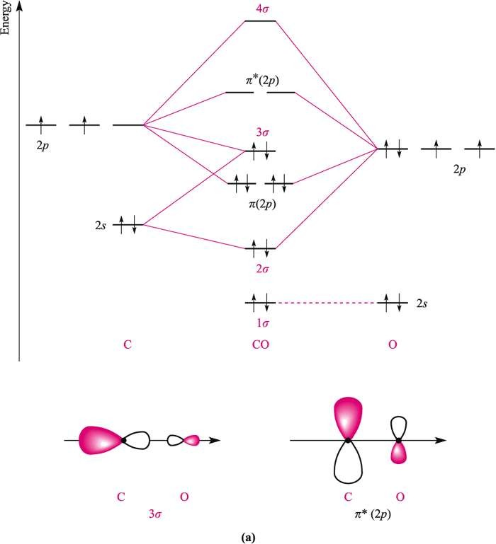
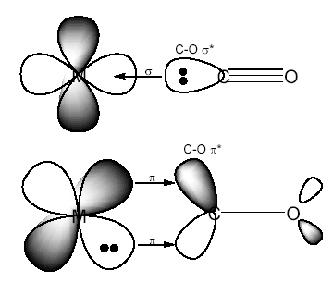
HOMO is lone pair on C. CO always binds to metals via the C end

