Slide 1
Study of Sericulture
Prin.Dr.L.S.Matkar
Introduction to Sericulture,And Study of different types of silkmoths in India
Zoology-II

Slide 2
Sericulture in India: History,Types Of silks
Silk has been under use by human beings for various purposes since ancient times. Pure silk is one of the finest and most beautiful natural fibres of the world and is said to be “the queen of fibres.” Silk clothes have a look and feeling of affluence that no other cloth can equal. Due to its great value and usefulness, there have been many attempts in various parts of the world for the large scale production of silk.One of the methods was the rearing of silkworms on large scale with great care in natural and controlled conditions.

Slide 3
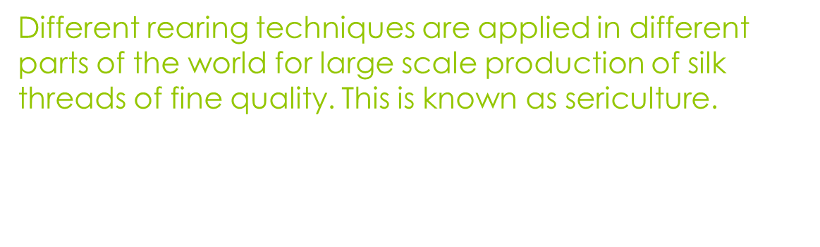
There is no authentic information regarding the origin and use of silk. The ancient literature gives two views. According to one view, silk industry originated for the first time in India at the foot of the Himalayas, and from there it spread to other countries of the world.
Second view, which has greater acceptance, says that this industry originated in China about 3000 B.C. According to this, a Chinese Princess Siling Chi was the first to discover the art of reeling an unbroken filament from a cocoon. (Story)
History:-

Slide 4
This art was kept a close secret for nearly 3000 years. This art later on spread to the rest of the world through several agencies like civil war refugees, war prisoners’ marriage of royal families etc.
Types of Silk:
Moths belonging to families Saturnidae and Bombycidae of order lepidoptera and class Insecta produce silk of commerce. There are many species of silk-moth which can produce the silk of commerce, but only few have been exploited by man for the purpose.

Slide 5
Mainly four types of silk have been recognised which are secreted by different species of silk worms.
i) Mulberry Silk:
This silk is supposed to be superior in quality to the other types due to its shining and creamy white colour. It is secreted by the caterpillar of Bombyx mori which feeds on mulberry leaves.adult moths are
Fat,25m.m long,creamy white in colour.
Larvae are voracious feeders,moths are
Univoltine i.e. Single brooded,some are multivoltine.cocoons are of various shape,size and colours ranging from white to yellow.

Slide 6
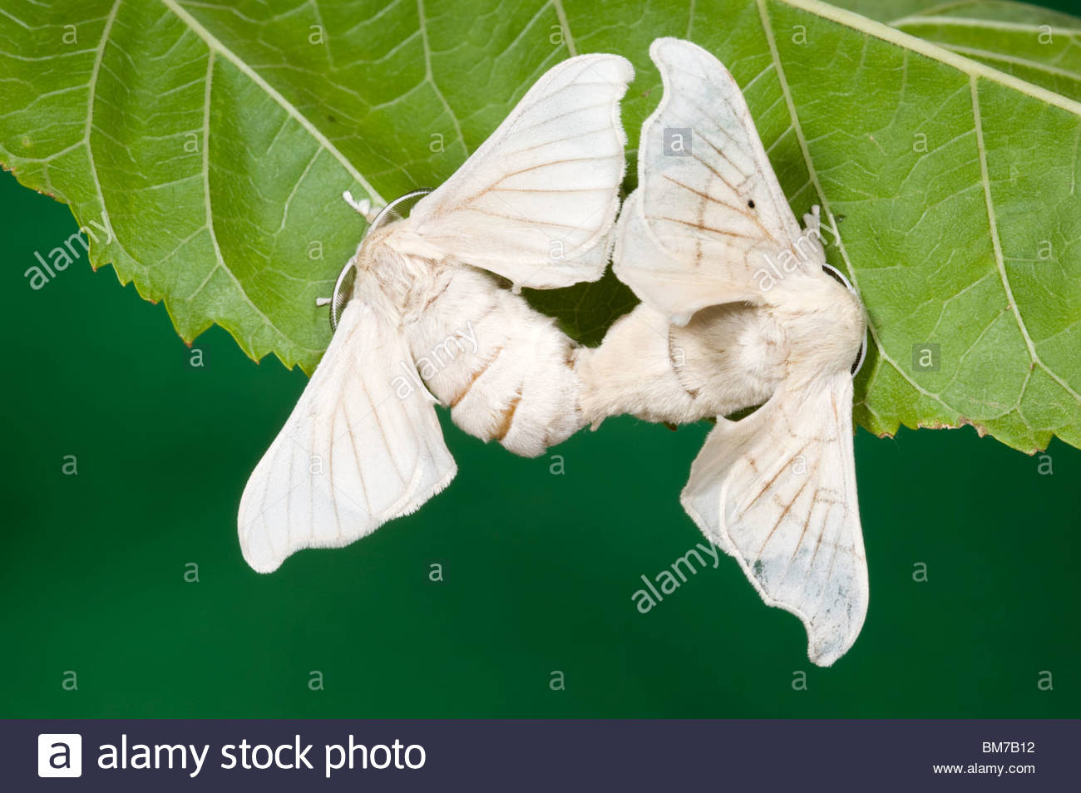
Mulberry moths adults :-

Slide 7
Taxonomic Position:-
Phylum-Arthropoda
Class-Insecta
Division-Endopterygota
Order- Lepidoptera
Family- Bombycidae
Genus-Bombyx
Species-mori
Mulberry silkworm

Slide 8
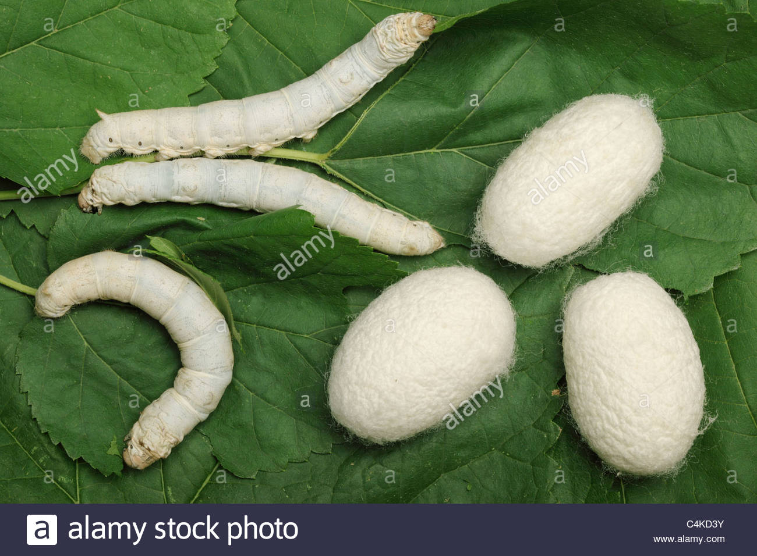
Larvae and cocoons of B.mori

Slide 9
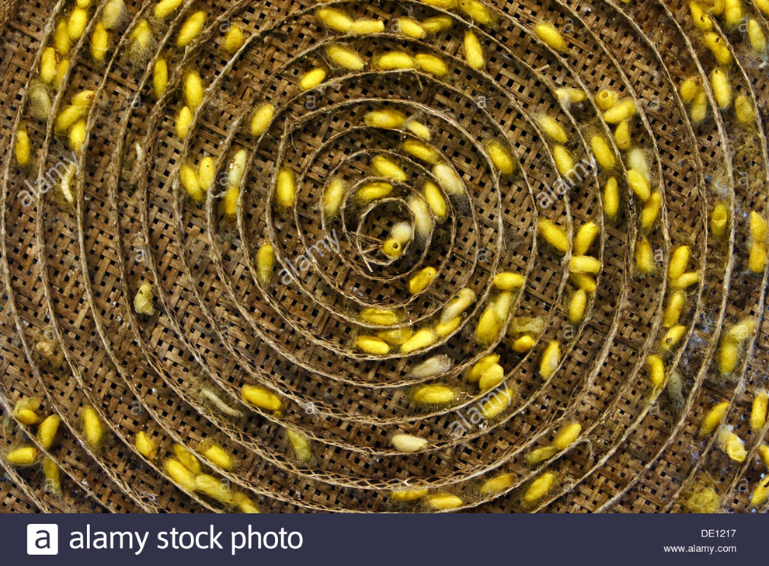

Slide 10
ii)Tassar silkmoth-
In India Tassar silk produced by Indian silkworm belongs to Antheraea mylitta and Chinese tassar silkworm is A.pernyi.
It disbruted belt along the Tropical forest
Beltof India starting fromBengal,Karnataka
U.P,M.P,Maharashtra,Orissa,Bihar.
It feeds on different plants like Terminalia,Sal,Arjun,Sidha,ber
Female Moths are large insects yellow brown in colour ,males smaller and brick red in colour have eyespots on wings.

Slide 11
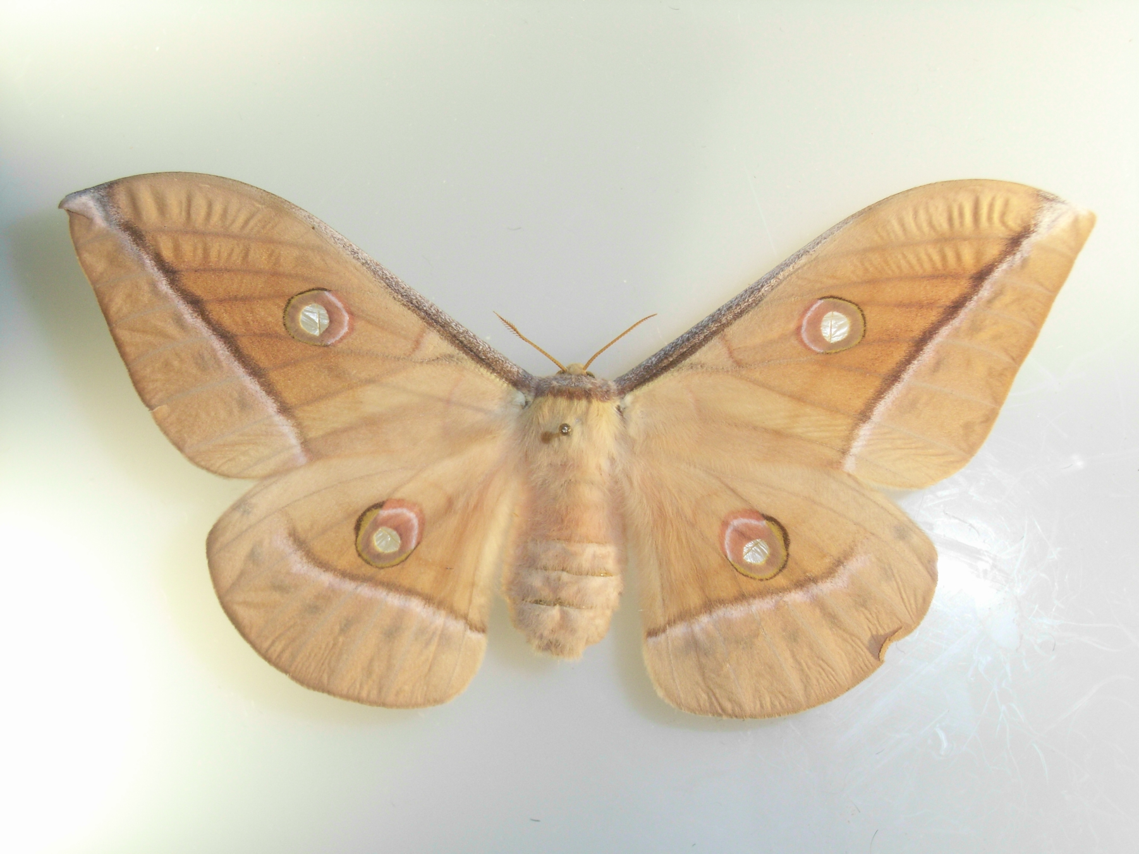

Slide 12
Classification:-
Phylum-Arthropoda
Class-Insecta
Division-Endopterygota
Order- Lepidoptera
Family-Saturnidae
Genus-Antheraea
Species-pernyi
Tassar silkworm produced brown or coppery
Cocoons/silk.

Slide 13
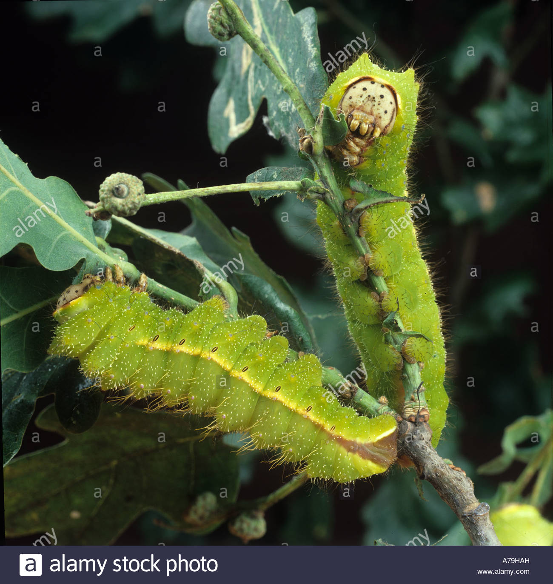
Catterpillars/larvae

Slide 14
(iii)Eri Silkworm:-
It is produced by caterpillars of Attacus ricini which feed on castor leaves.It also feeds on Kesseru,Barkkesseru. Abdomen of adult is wooly white.Both males and females have black,brown and green wings with white crescent markings.They
Are multivoltine.Larvae havings white,blue,And green zebra markings .Silk
Threads not continuous or uniform so knowen as “poor mans wool”/poor mans silk.

Slide 15
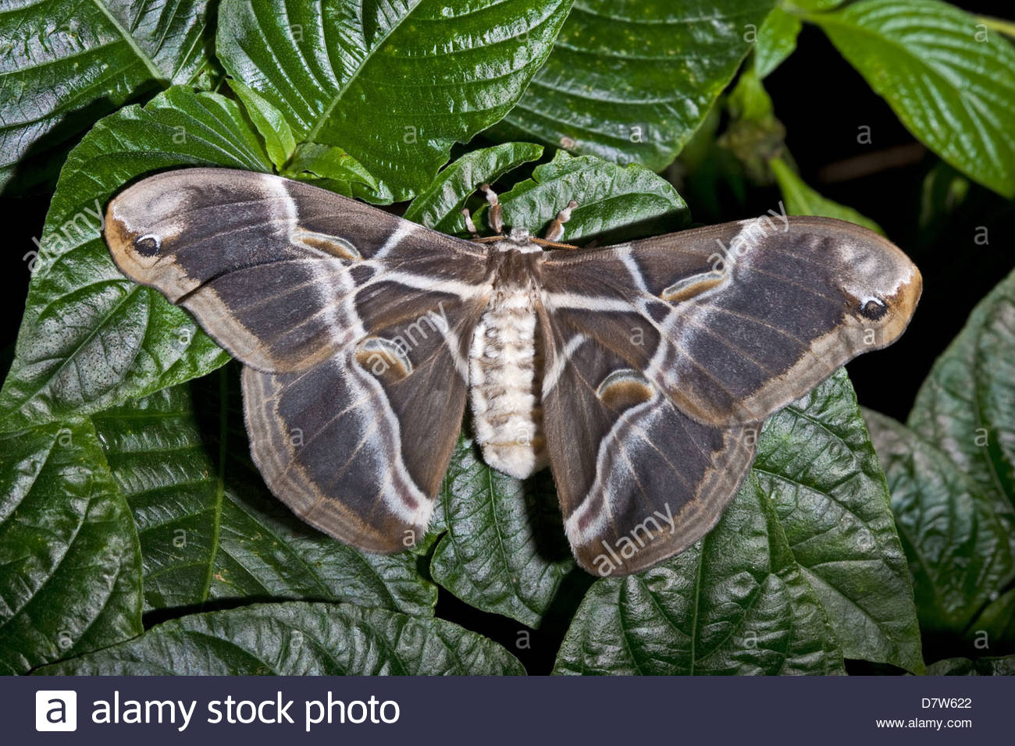
Eri Female moth:-

Slide 16
Taxonomic Position:-
Phylum-Arthropoda
Class-Insecta
Division-Endopterygota
Order-Lepidoptera
Family- Saturnidae
Genus-Attacus
Species-ricini
It produces creamy-white silk which is unreelable

Slide 17
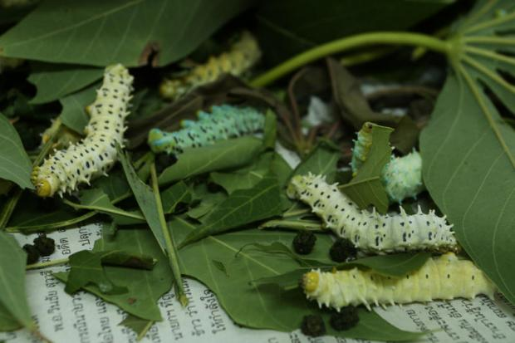
Larvae:-

Slide 18
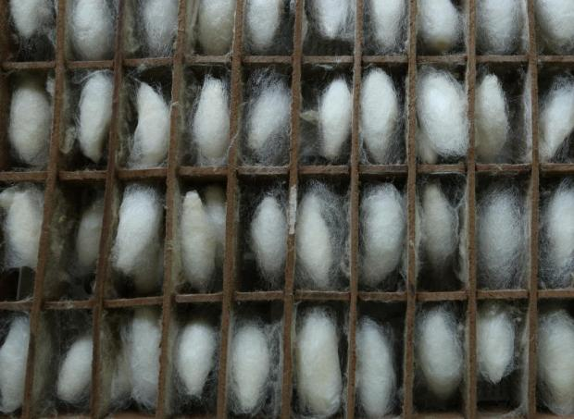
Cocoons of Eri:-

Slide 19
(iv)Muga silkworm:-
Antheraea assama known as tassar worms ,they produce lustrous golden yellow silk threads which are strong and attractive .Muga feeds on Som and Soalu.
It is distributed in Western Himalaya to Nagaland,Tripura,and Assam.Male Moths
Are Copper brown or dark and females
Yellow brown in colour.Both pair of wings have eyespots.Silk used in traditional ceremonies like marriages and festivals

Slide 20
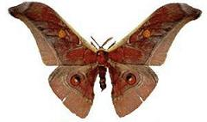
Muga Moth:-

Slide 21
Taxonomic Position:-
Phylum-Arthropoda
Class-Insecta
Division-Endopterygota
Order- Lepidoptera
Family-Saturnidae
Genus- Antheraea
Species- assama
Golden silk used for making Mekhala and
Chadhar.

Slide 22
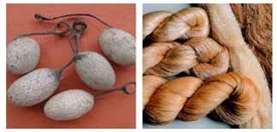
Cocoons and silk of muga:-

Slide 23
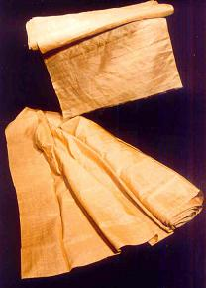
Cloths

Slide 24
Different silkmoths, And their food material
Shown in following chart:-
Common name | Scientific Name | Food Plants
Mulberry silkworm | Bombyx mori(white to yellow cocoons) | Mulberry leaves
Eri silkworm | Attacus ricini (White silk) | Castor (era )plant,Kasseru
Tasar silkworm | Antheraea mylitta(Brown Or coppery cocoons) | Sal,Ber Arjun
Muga silkworm | Antheraea assama (golden cocoons) | Som.and Soalu

Slide 25
Life-Cycle:-
All four types of moths have same life cycle male and female mates .Female lays large amount of eggs on leaves of food plant then female dies, males dies immediately after mating. Eggs hacthed to produce cater-pillars or larve which gives rise to pupal stage ,cocoon produced by last larval stage for prtection of pupa,from which adult arises.

