Slide 1
ECOLOGY
ANIMAL INTERACTIONS
Dr.V.M.Gangotri
Zoology-II

Slide 2
Intraspecific inter-relations:-
A.Competition:- Intraspecific competition is an interaction in population ecology, whereby members of the same species compete for limited resources. This leads to a reduction in fitness for both individuals, but the most fit individual survives and is able to reproduce.[1] By contrast, interspecific competition occurs when members of different species compete for a shared resource. Members of the same species have rather similar requirements for resources, whereas different species have a smaller contested resource overlap, resulting in intraspecific competition generally being a stronger force thaninterspecificcompetition. [2]Individuals can compete for food, water, space, light, mates or any other resource which is required for survival or reproduction. The resource must be limited for competition to occur; if every member of the species can obtain a sufficient amount of every resource then individuals do not compete and the population grows exponentially.[1] Prolonged exponential growth is rare in nature because resources are finite and so not every individual in a population can survive, leading to intraspecific competition for the scarce resources.

Slide 3
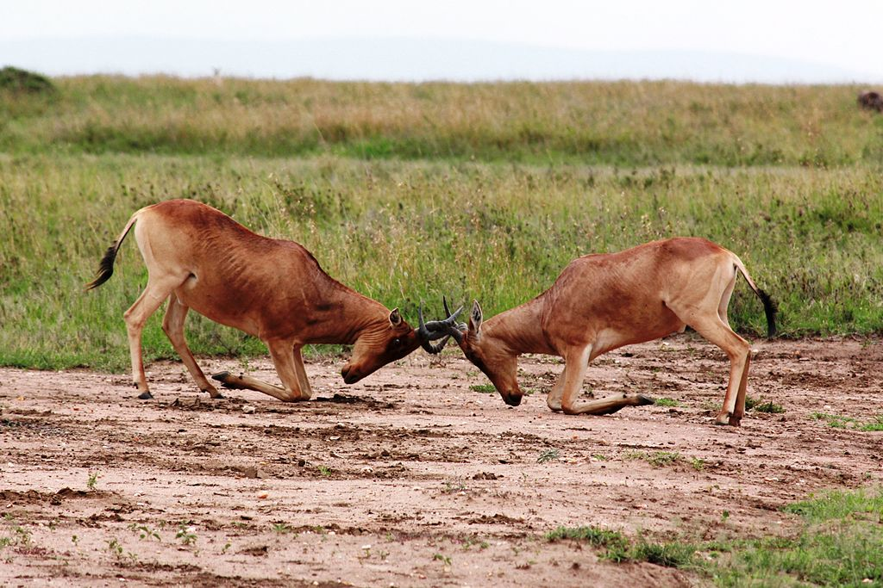

Slide 4
Interspecific interrelations:-
B.Association:-Planet earth is home to millions of species of very diverse, living organisms that include plants, animals, fungus, algae, and unicellular organisms. Likewise, there are millions of complex relationships taking place between and among these differing species of organisms. Many organisms live together in diverse, intricate relationships. The term Symbiosis (sym meaning “together” and biosis meaning “living,” thus living together”) descried any association, either temporary or permanent, between at least two living organisms of different species. Each member of this association is called a symbiont.
The most of animals live independently in their natural habitats, obtaining their own food material and utilizing free water and oxygen for their metabolic processes. These animals when live in close association, develop a variety of patterns of association. These are mainly of five types:-

Slide 5
1. Parasitism
2. Commensalism
3. Phoresis
4. Mutualism
5. Symbiosis.
Of these associations, commensalisms is a loose association made on a basis of shelter, defence of food-obtaining mechanisms where as parasitism, mutualism and symbiosis are intimate associations in which the metabolism of an individual of one species is dependent to some degree on permanent association with an individual of another species.
Parasitism:-
It is an intimate association between two specifically distinct organisms in which one partner usually smaller lives on or within the other usually larger in order to obtain sustenance. The one which is benefited is known as the parasite

Slide 6
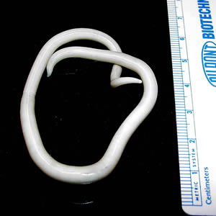
Ascaris-(Jant)

Slide 7
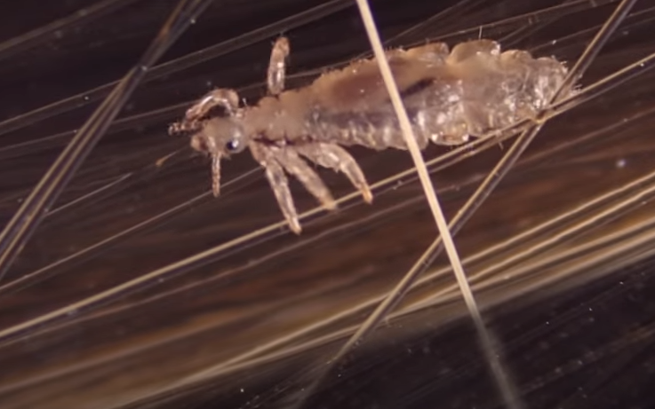
Head louse

Slide 8
while the other which is injured, the loser to a smaller or a larger extent, but certainly does not gain anything by this association is known as the host or parasitism is a way of living in which an organism, the parasite, uses an organism of a different species, the host – both as a habitat and as food.
Commensalism
The literal meaning of the commensalisms is eating at the same table. It is a loose association in which two animals or organisms of different species live together without either being metabolically dependent on the other although one animal may receive some benefit called commensal but the other neither get benefit nor harm from the other. However, it is not obligatory for their existence, e, g.
1. Many intestinal protozoa such as Entamoeba coli and Trichomonas sp. live in intestine as commensal without causing any harm to host.
2. Pilot fish and shark: The pilot fish (Naucrates doctor) accompanies the shark in a free-swimming manner eating the fragments of food that become available as the shark tears apart its prey.

Slide 9
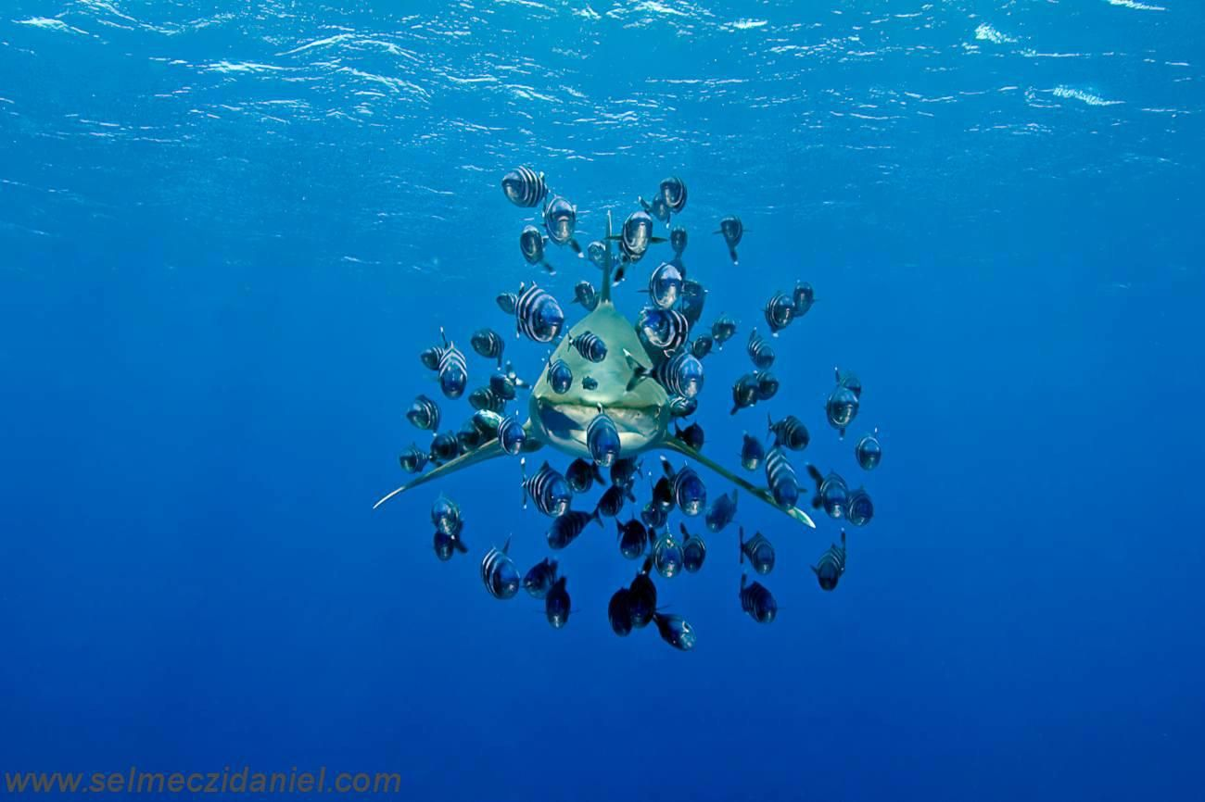
Shark and pilot fish

Slide 10
3. Remora and shark : The remora (Echeneis remora) actually attaches itself to the shark by its dorsal fin and feeds on “left over” and does not harm the shark.
4. Crab and sea-urchin: The crab (Eumedon conuictor) lives I a large cavity found on the back of the sea-urchin (Echinothrix turca). The crab does not exert any energy in swimming around the host, on the other hand, it shares the food of the sea-urchin and enjoys its protection.
5. Similar relationship is also seen between Pocillopora and Hapalocarcinus marsupialis (a crab).

Slide 11
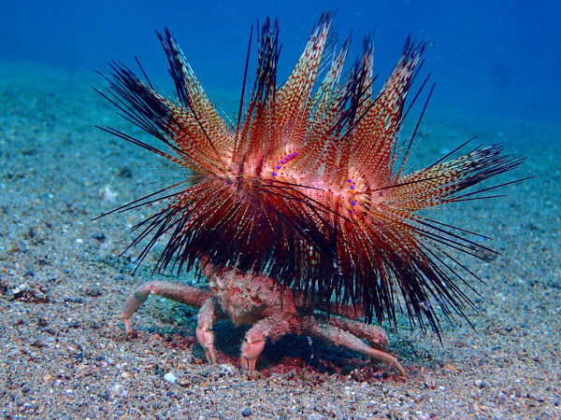
Crab and sea urchin

Slide 12
Mutualism
It is derived from the Latin word mutuus means exchange. It is an intimate association or relationship of two animals or individuals in which both the partners are benefited, However, this relationship is not permanent and obligatory. Either of the partners can break it without any loss to either of them, e.g.
1. Hermit crab and sea anemone lives on the back of a crab. The anemone is benefited by being moved to new hunting grounds and obtaining morsels of food torn off by the crab, while the crab is protected by the bulk and stinging tentacles of the bulk and stinging tentacles of the anemone.
2. In the herbivores ruminal flora help in the digestion of cellulose in ruminants and in return get the protection and food.

Slide 13
Symbiosis:-It comes from the greeek word symbioun means to live together. This term was first used by de Bary in 1879. It is an intimate or close association or relationship of two individuals in which both the partners are benefited like mutualism but in this he participating species are dependent on each other for existence and are obligatory, e.g.1. Termites and their intestinal protozoa The termites provide the habitat and the food in the form of wood (cellulose) which they cannot digest. The protozoa in the intestinal habitat, however, are capable of hydrolyzing the wood for their own and the termites use.
2. Zoochlorella and Hydra Zoochlorella lives in the cells of hydra, hence gest the protection. Secondly the CO2 produced by hydra, is taken and utilized in food making and release the O2 which is utilized by the hydra. In this way both are benefited.

Slide 14
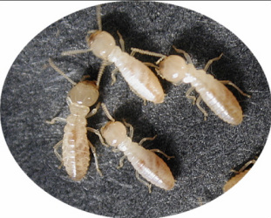
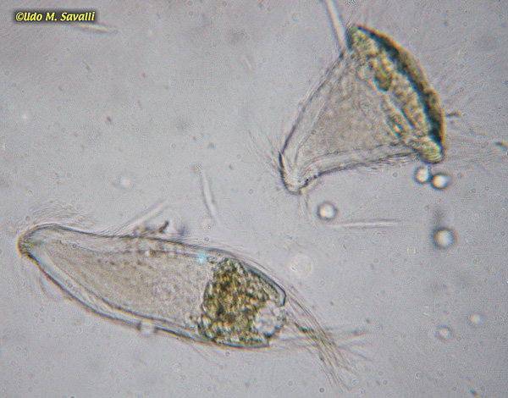
Termite and trichonympha

Slide 15
Phoresis
The term means “Traveling together”. It is a temporary association between two individuals or living beings in which where is no metabolic dependence. Example: Bacteria and amoebae on the legs of fly or fungal spores on the legs of a beetle.

Slide 16
In ethology, an aggregation is any form of gathering of organisms and the process of coming together. In some forms groups of unrelated species might form, in which interaction between members of the aggregation might be minimal; for example herds of grazing zebra and antelopes might combine, both the better to observe the approach of predators, and to improve the odds of escape in the event of attack by predators. Sometimes there might be some interaction, such as mixed flocks of birds that observe for searching for food. Sometimes there might be quite orderly common action, such as the queuing up for a resource; for example different species of fishes may aggregate around a cleaning station where cleaner wrasse and cleaner shrimp are active, more or less taking turns for attention. Such aggregations, where there is no particular association of species or sizes, may be referred to loosely as unstructured aggregations. Commonly they are very temporary and may be loose, with flocks or herds associating casually and separating equally casually within hours.

Slide 17
Agreegations in animals-
Typically, though not necessarily, they will be of a single species. Often they will be of a single age and possibly of a single sex, such as shoals of fish fry that have specific ecological requirements that are not compatible with those of the mature species. One class of such aggregations comprises groups of adult, but immature "bachelor" males of elephants, seals, lions and other animals in which the mature herd will not tolerate males that would begin to compete with the dominant males. Another is when aposematic larvae of certain insects such as some Lepidoptera and Hemiptera form a flock that feed together and may migrate in "processions" until they are mature after which some kinds disperse.

Slide 18
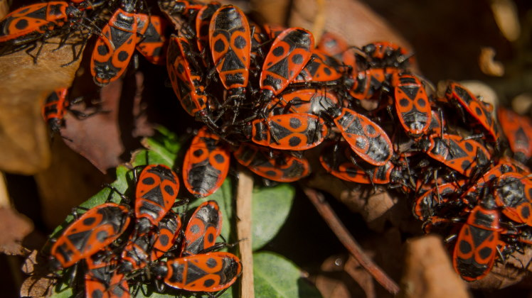
Aggregation in insects

Slide 19
Mutualism:-
A mutualistic relationship is when two organisms of different species "work together," each benefiting from the relationship. One example of a mutualistic relationship is that of the oxpecker (a kind of bird) and the rhinoceros or zebra. Oxpeckers land on rhinos or zebras and eat ticks and other parasites that live on their skin. The oxpeckers get food and the beasts get pest control. Also, when there is danger, the oxpeckers fly upward and scream a warning, which helps the symbiont (a name for the other partner in a relationship).

Slide 20
Organisms in a mutualistic relationship evolved together. Each was part of the other's environment, so as they adapted to their environment, they "made use of" each other in a way that benefited both.
Here are three other examples of mutualistic relationships:
1. The bee and the flower. Bees fly from flower to flower gathering nectar, which they make into food, benefiting the bees. When they land in a flower, the bees get some pollen on their hairy bodies, and when they land in the next flower, some of the pollen from the first one rubs off, pollinating* the plant. This benefits the plants. In this mutualistic relationship, the bees get to eat, and the flowering plants get to reproduce.

Slide 21
2. The spider crab and the algae. Spider crabs live in shallow areas of the ocean floor, and greenish-brown algae lives on the crabs' backs, making the crabs blend in with their environment, and unnoticeable to predators. The algae gets a good place to live, and the crab gets camouflage.**
3. The bacteria and the human. A certain kind of bacteria lives in the intestines of humans and many other animals. The human cannot digest all of the food that it eats. The bacteria eat the food that the human cannot digest and partially digest it, allowing the human to finish the job. The bacteria benefit by getting food, and the human benefits by being able to digest the food it eats.

Slide 22
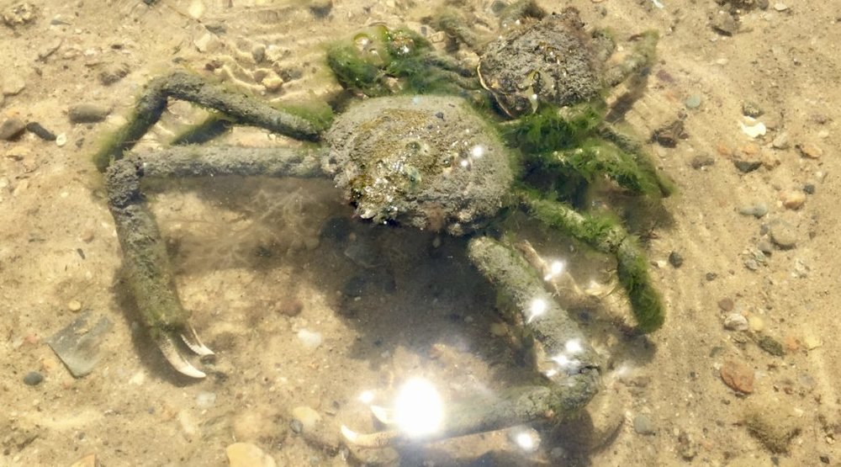
Spider crab and algae

Slide 23
Parasitism:-
Parasitism is a symbiotic relationship between species, where one organism, the parasite, lives on or inside another organism, the host, causing it some harm, and is adapted structurally to this way of life.[1] The entomologist E. O. Wilson has characterised parasites as "predators that eat prey in units of less than one".[2] Parasites include protozoans such as the agents of malaria, sleeping sickness, and amoebic dysentery; animals such as hookworms, lice, mosquitoes, and vampire bats; fungi such as honey fungus and the agents of ringworm; and plants such as mistletoe, dodder, and the broomrapes. There are six major parasitic strategies of exploitation of animal hosts, namely parasitic castration, directly transmitted parasitism (by contact), trophically transmitted parasitism (by being eaten), vector-transmitted parasitism, parasitoidism, and micropredation.Like predation, parasitism is a type of consumer-resource interaction,[3] but unlike predators, parasites, with the exception of parasitoids, are typically much smaller than their hosts, do not kill them, and often live in or on their hosts for an extended period. Parasites of animals are highly specialised, and reproduce at a faster rate than their hosts. Classic examples include interactions between vertebrate hosts and tapeworms, flukes, the malaria-causing Plasmodium species, and fleas.

Slide 24
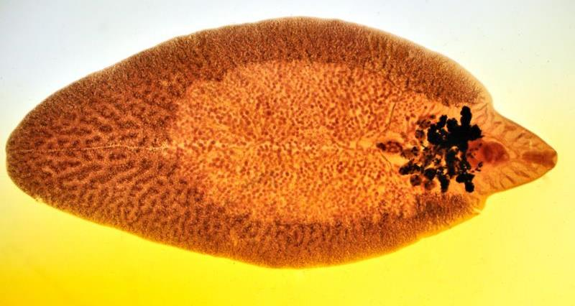
Parasites of animals are highly specialised, and reproduce at a faster rate than their hosts. Classic examples include interactions between vertebrate hosts and tapeworms, flukes, the malaria-causing Plasmodium species, and fleas

Slide 25
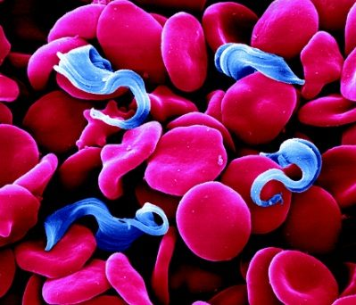
Trypanosoma blood parasite

Slide 26
Prey-predation relationship:-
HERBIVORES PREY ON GREEN PLANTS.
Carnivores predate on herbivores.
Top predators feeds on lower carnivoes.
Parasites depends on plants or animals as hosts.
Cannabalism- animals predates on their own species.
Physical adaptations of predators :-
Sharp claws
Sharp teeths
Powerful jaws
Nocturnal hunting
Teaching to younones how to kill prey.

Slide 27
Intraspecific Association:-
A territory is an administrative division, usually an area that is under the jurisdiction of a state. In most countries, a territory is an organized division of an area that is controlled by a country but is not formally developed into,[1] or incorporated into, a political unit of the country that is of equal status to other political units that may often be referred to by words such as "provinces" or "states". In international politics, a territory is usually either the total area from which a state may extract power resources[2] or any non-sovereign geographic area which has come under the authority of another government; which has not been granted the powers of self-government normally devolved to secondary territorial divisions; or both.

Slide 28
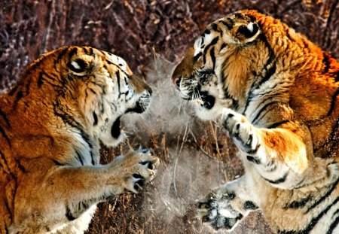
Territorial fight-

Slide 29
Types of territory:-
Moving /Floating:- troops of baboons defend their sleeping trees and their food searching area.Their territorial requirment moves with group.
Nesting territory:- Many sea birds defend only their nests and area adjacent to them i.e. have nesting territory.
Mating Territory:-Male birds and mammals defend territories for breeding.
Feeding territory :-Few insects,fishes and lizards,and mammals shows feeding territory.

Slide 30
Defence methods in animals:-
1.Camouflage- similarity with environment for protection. Ex. Frog changes colour according to surroundings.
2.Mark of territory
3.Herds- many animals forms herds for protection ,their offsprings stay hidden to mothers
4.Fight:- when predator attack most of the herbivores fight with them.
5.Sneezing type whistle- When deers senses predator gives low whistle to alert the herd.

